Slide 1
Objects
Bringing it all together

Slide 2
Previously, in IMM120
.unshift(value)
.push(value)
[ value, 1, 2, 3 ]
[ 1, 2, 3, value ]
[1, 2, 3]
x = .shift()
x = .pop()
[ 2, 3 ]
[ 1, 2 ]

Slide 3
Object-Oriented Programming

Slide 4
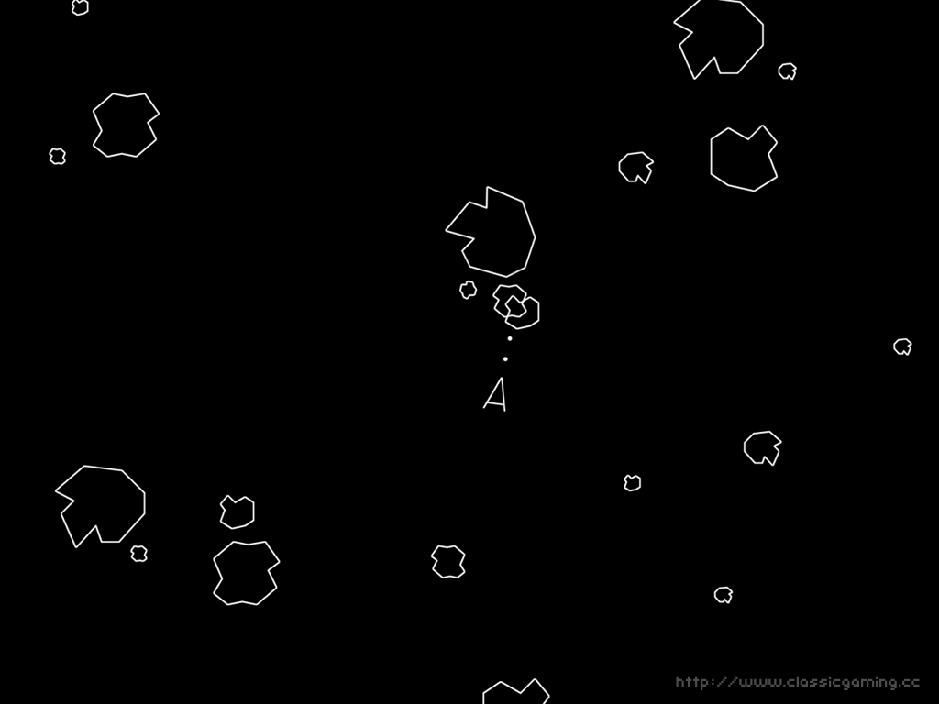

Slide 5
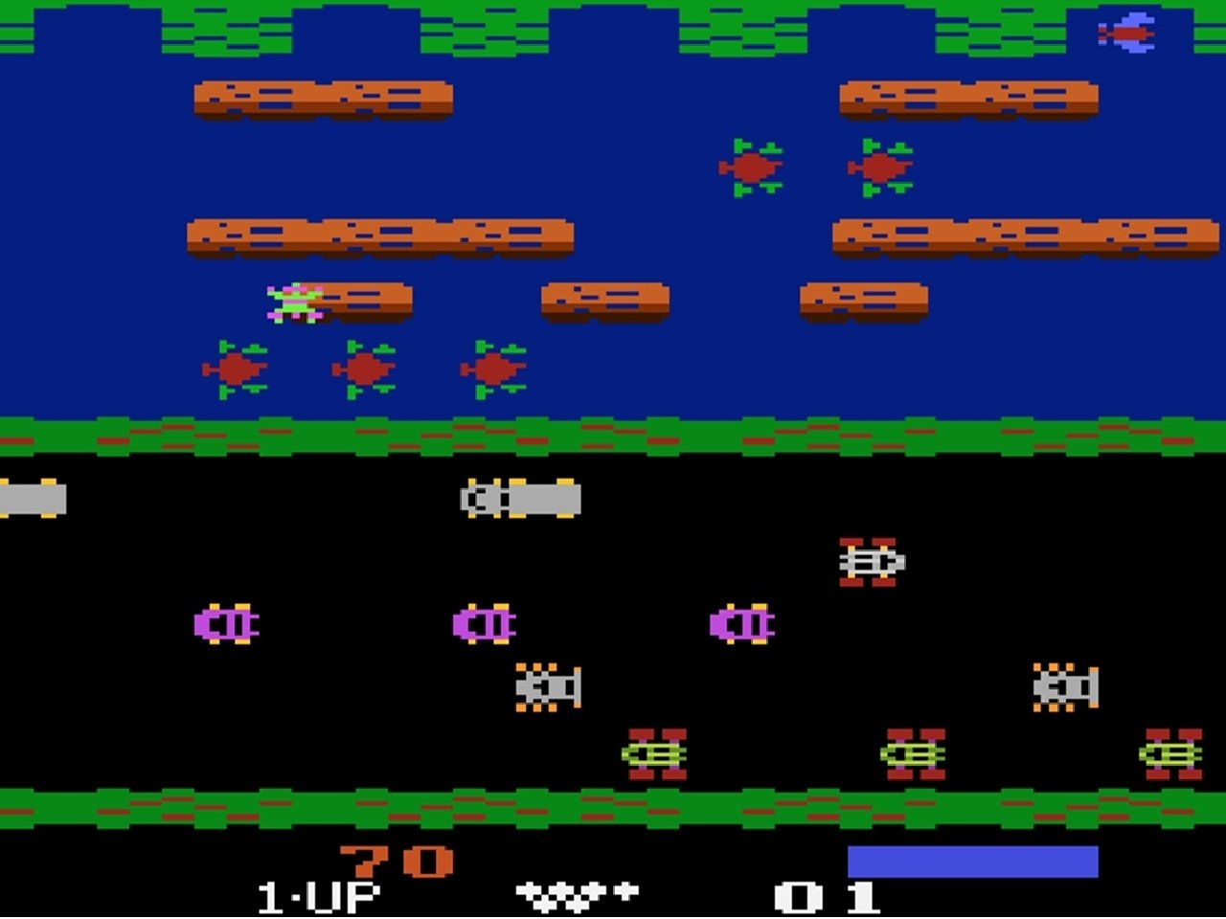

Slide 6
A Structure of Arrays
var x = [100, 150, 200];
var y = [200, 0, 300];
var w = [400, 50, 100];
var h = [100, 200, 200];

Slide 7
A Structure
{
x: 100,
y: 200,
width: 400,
height: 100
}

Slide 8
The Format
{
x: 100,
y: 200,
width: 400,
height: 100
}
Brackets frame the object
Keys (like “x” and “width”) give names to the values.
Same variable name rules
“quotes allow anything”
Colons end the key
Values (like 200) can be anything.
Commas separate key-value pairs.

Slide 9
Making Objects
Just save it to a variable, as is.
var rect = {
x: 100,
y: 200,
width: 400,
height: 100
};

Slide 10
Using Objects
rect.x // how to get
rect[“x”] // any key
rect(obj.x, obj.y, obj.width, obj.height);

Slide 11
Using Objects
Change the values at any time
rect.width = 500;
Add keys at any time
rect.fill = color(100, 200, 255);

Slide 12
https://cdpn.io/e/bYePRw
An Array of Structures
Back to the Bubbles!

Slide 13
for-in (a simpler loop)
for (var key in obj) {
// x
// y
// width
// height
obj[key]
}
{
x: 100,
y: 200,
width: 400,
height: 100
}

Slide 14
for-in and arrays
for (var key in arr) {
// 0
// 1
// 2
// 3
arr[key]
}
[
2,
45,
“word”,
78
]

Slide 15
Handling Objects with Functions
Passing an object into a function is a very good way to keep all of your code organized
https://cdpn.io/e/RjgLpN

Slide 16
Diving Into An Object
{
x: 100,
y: 200,
dimensions: {
width: 400,
height: 100
}
}
var dim = obj.dimensions;
dim.width // 400
dim.x // ????

Slide 17
https://cdpn.io/e/ZayeGW
Choose Your Own Adventure
An example in navigating Javascript Objects

Slide 18
https://cdpn.io/e/GOEOgm Making A Particle System
Let’s Make Some Fireworks

Slide 19
